Slide 1

Seasonal Agriculture Performance Analysis
DEEPIKA E
(GRT Institute of Engineering and Technology)
AICTE STU ID : STU6a53a459d65121783866457

Slide 2

PROBLEM STATEMENT
Agricultural activities are influenced by seasonal variations in environmental conditions, farming practices, resource availability and market conditions. As a result, agricultural performance may differ from one season to another. However, raw agricultural data does not clearly explain how agricultural performance changes across seasons or what patterns can be observed in different seasonal conditions. The problem is to analyze the given agricultural dataset and investigate seasonal differences in agricultural performance by identifying meaningful patterns, trends, relationships and variations within the available data.

Slide 3
Project Description: This project is about analyzing a seasonal agriculture dataset which has around 4000 records and 28 columns, covering 3 seasons, 8 states, 8 crops and 4 irrigation methods. I first cleaned the dataset (handled missing values, checked duplicates), then did statistical, univariate, bivariate, multivariate and outlier analysis using Python. I used different types of graphs like histograms, boxplots, scatter plots, heatmaps and pairplots to understand the data better. The main aim was to compare yield, profit, water usage and disease/pest risk across the 3 seasons, and also check how factors like irrigation method, crop type and rainfall affect the results. At the end I wrote conclusions and some recommendations based on what I found.

Slide 4

WHO ARE THE END USERS?
- Farmers, who can use these insights to choose better crops and irrigation methods for each season
- Agriculture department / government officials, for planning seasonal support and subsidies
- Agri-business and supply chain companies, to plan resources according to seasonal trends
- Researchers and students, who want to study seasonal patterns in agriculture data

Slide 5

Technology Used
- Python
- Google Colab
- Pandas (data cleaning and analysis)
- NumPy (numerical operations)
- Matplotlib and Seaborn (data visualization)
- CSV dataset (seasonal_agriculture_performance_dataset.csv)

Slide 6
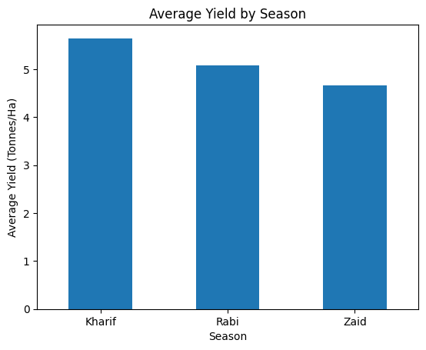
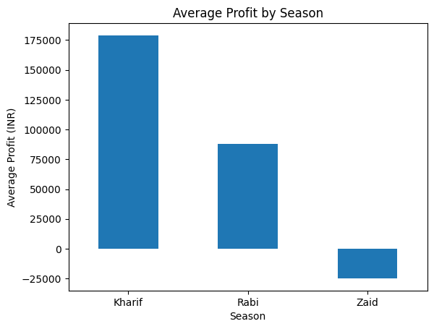
RESULTS
Kharif season shows the highest average yield and profit, while Zaid season shows a loss on average.

Slide 7
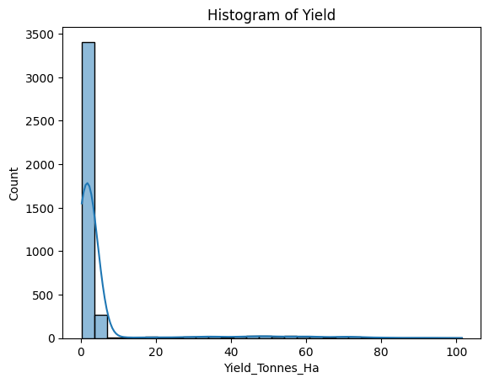
RESULTS
Yield, Profit and Production columns are right-skewed, meaning a few farms have very high values compared to most others.

Slide 8
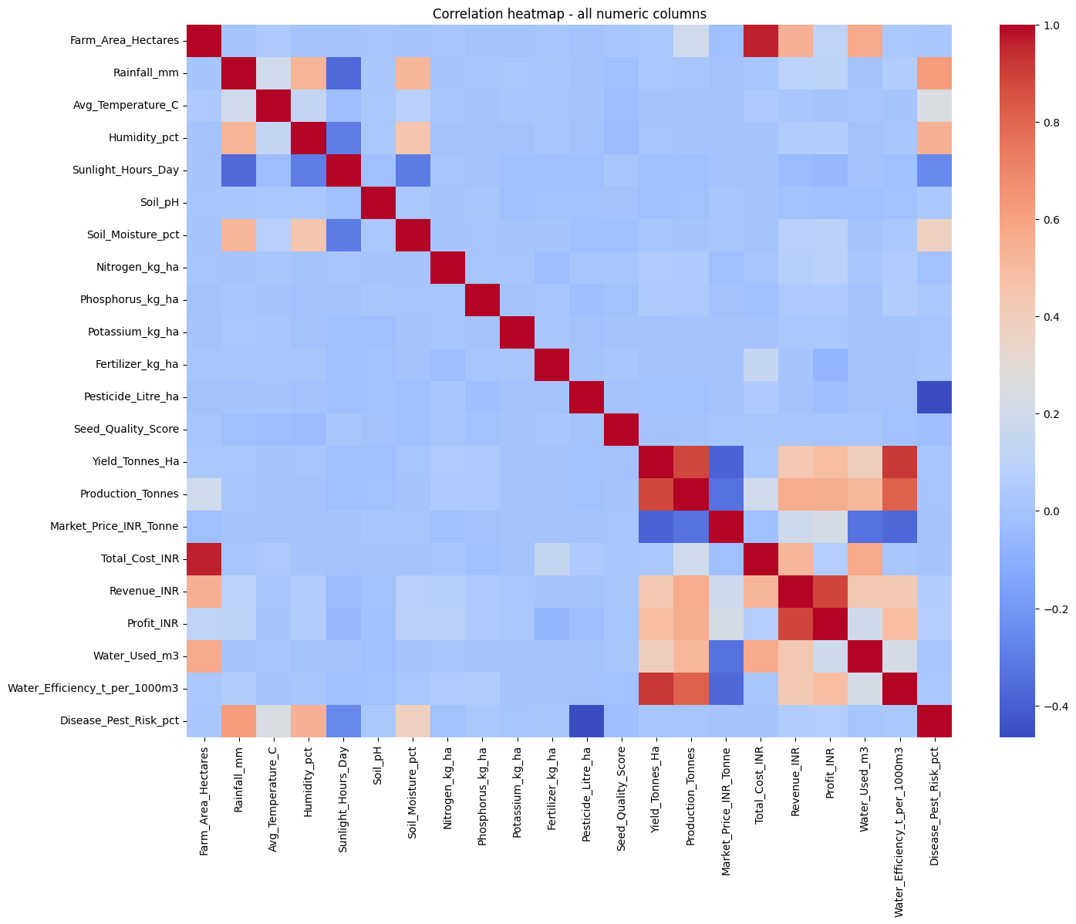
RESULTS
Yield is most strongly related to Water_Efficiency and Production, while factors like rainfall alone don't show strong correlation.

Slide 9
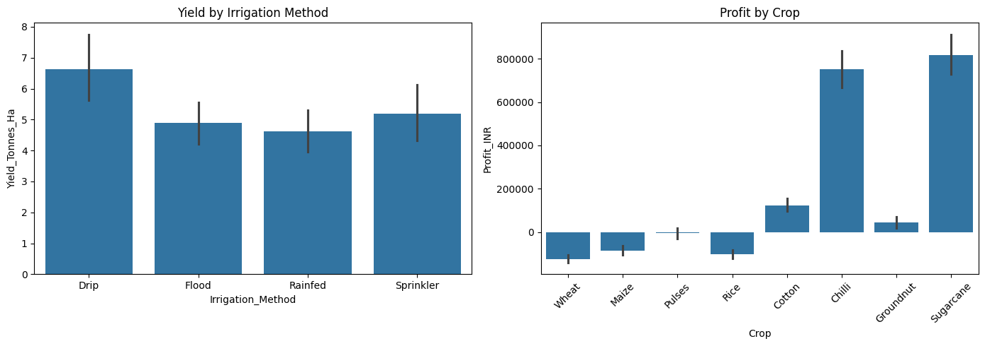
RESULTS
Drip irrigation gives the best average yield, and cash crops like Sugarcane and Chilli are more profitable than staple crops like Rice and Wheat.

Slide 10
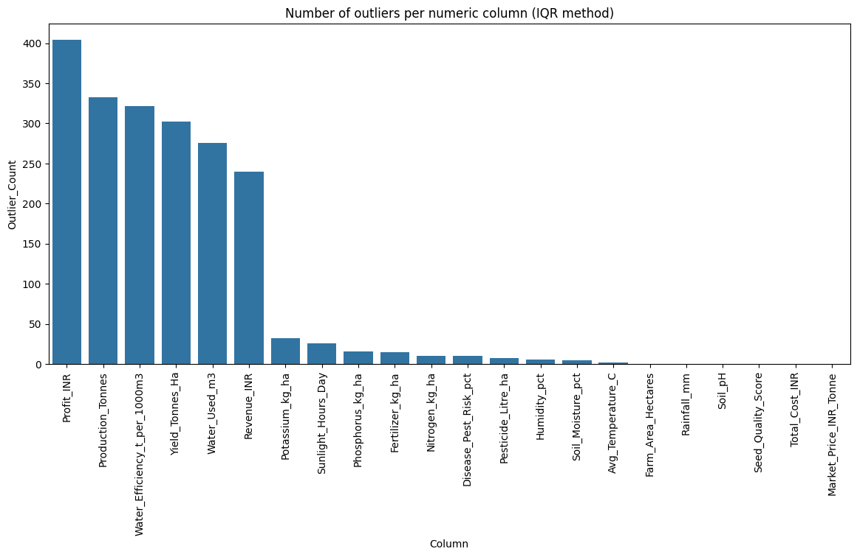
RESULTS
Yield, Profit, Production and Water_Efficiency have the most outliers, matching their high skewness values found earlier.

Slide 11
Future scope
- This analysis can be extended with multiple years of data to study long term seasonal trends, not just one snapshot
- Machine learning models can be built to predict yield or profit based on season, crop and weather conditions
- The outlier/high-performing farms can be studied in more detail to find best practices that other farmers can follow
- A dashboard can be built so that farmers or officials can check seasonal insights easily without needing to run code

Slide 12
GitHub Link
https://github.com/deepikae1504/Seasonal_agriculture_performance_analysis.git

Slide 13
VOIS Course completion certificate - Course name- Data Visualization

Slide 14
Thank you
.
.

